Slide 1
Introduction to Data Structures and Algorithms

Slide 2
Basic Terminology
When selecting a data structure to solve a problem, the following steps must be performed.
1. Analysis of the problem to determine the basic operations that must be supported. For example, basic operation may include inserting/deleting/searching a data item from the data structure.
2. Quantify the resource constraints for each operation.
3. Select the data structure that best meets these requirements.

Slide 3
Elementary Data Structure Organization
Data represents a single value or a set of values assigned to entities.
Data item refers a single or group of values with in the data
An entity is a thing that has some properties which can take
values.
Processed or meaning full data is called information. This is
used for taking some action.

Slide 4
Classification Of Data Structures
Data structures are generally categorized into two classes:
Primitive data structures.
non-primitive data structures.

Slide 5
Primitive Data Types
These are the data structures which are directly supported by the machine.i.e.Any operation can be performed in these data items.
The different primitive data types are
Integer
Float
Double
Character
boolean

Slide 6
Non Primitive Data Types
These Datastructures do not allow any specific instructions to be performed on the Data items directly.
The different non primitive data types are
Arrays
Structures
Unions
Class etc.

Slide 7
Linear and Non-linear Data Structures
Linear Data Structure: Linear data structures can be constructed as a continuous arrangement of data elements in the memory. It can be constructed by using array data type. In the linear Data Structures the relationship of adjacency is maintained between the data elements.
Non-Linear Data Structure: Non-linear data Structure can be constructed as a collection of randomly distributed set of data item joined together by using a special pointer (tag). In non-linear Data structure the relationship of adjacency is not maintained between the data items
‹#›

Slide 8
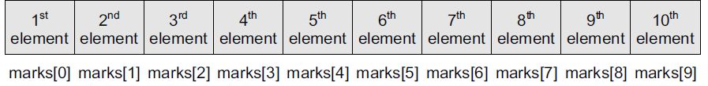
Array
An array is a collection of similar data elements.
These data elements have the same data type.
The elements of the array are stored in consecutive memory locations and are referenced by an index (also known as the subscript).
In C, arrays are declared using the following syntax:
type name[size];
For example,
int marks[10];
The above statement declares an array marks that contains 10 elements.
In C, the array index starts from zero.
This means that the array marks will contain 10 elements in all.
The first element will be stored in marks[0], second element in marks[1], so on and so forth.
Therefore, the last element, that is the 10th element, will be stored in marks[9].
In the memory, the array will be stored as shown in Fig.

Slide 9
Linked Lists
A linked list is a very flexible, dynamic data structure in which elements (called nodes) form a sequential list.
In contrast to static arrays, a programmer need not worry about how many elements will be stored in the linked list.
This feature enables the programmers to write robust programs which require less maintenance.
In a linked list, each node is allocated space as it is added to the list.
Every node in the list points to the next node in the list. Therefore, in a linked list, every node contains the following two types of data:
The value of the node or any other data that corresponds to that node
A pointer or link to the next node in the list
The last node in the list contains a NULL pointer to indicate that it is the end or tail of the list.
Since the memory for a node is dynamically allocated when it is added to the list, the total number of nodes that may be added to a list is limited only by the amount of memory available.

Slide 10
Stack
A stack is a linear data structure in which insertion and deletion of elements are done at only one end, which is known as the top of the stack.
Stack is called a last-in, first-out (LIFO) structure because the last element which is added to the stack is the first element which is deleted from the stack.
In the computer’s memory, stacks can be implemented using arrays or linked lists.
Figure shows the array implementation of a stack.
Every stack has a variable top associated with it.
Top is used to store the address of the topmost element of the stack.
It is this position from where the element will be added or deleted.
There is another variable MAX, which is used to store the maximum number of elements that the stack can store.

Slide 11
Stack
If top = NULL, then it indicates that the stack is empty and if top = MAX–1, then the stack is full.
A stack supports three basic operations: push, pop, and peep.
The push operation adds an element to the top of the stack.
The pop operation removes the element from the top of the stack.
And the peep operation returns the value of the topmost element of the stack (without deleting it).
However, before inserting an element in the stack, we must check for overflow conditions.
An overflow occurs when we try to insert an element into a stack that is already full.
Similarly, before deleting an element from the stack, we must check for underflow conditions.
An underflow condition occurs when we try to delete an element from a stack that is already
empty.

Slide 12
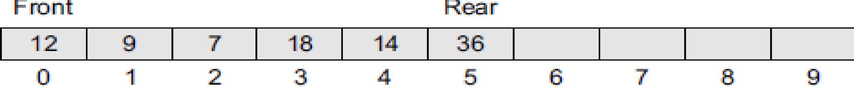
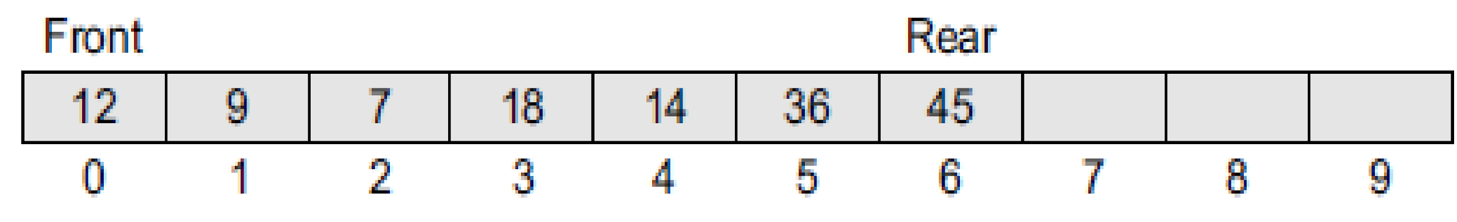
Queues
A queue is a first-in, first-out (FIFO) data structure in which the element that is inserted first is the first one to be taken out.
The elements in a queue are added at one end called the rear and removed from the other end called the front.
Like stacks, queues can be implemented by using either arrays or linked lists.
Every queue has front and rear variables that point to the position from where deletions and insertions can be done, respectively.
Consider the queue shown in Fig.
Here, front = 0 and rear = 5.
If we want to add one more value to the list, if we want to add another element with the value 45, then the rear would be incremented by 1 and the value would be stored at the position pointed by the rear.
The queue, after the addition, would be as shown in Fig.
.

Slide 13
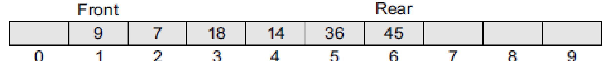
Queues
Here, front = 0 and rear = 6.
Every time a new element is to be added, we will repeat the same procedure.
Now, if we want to delete an element from the queue, then the value of front will be incremented.
Deletions are done only from this end of the queue.
The queue after the deletion will be as shown in Fig

Slide 14
Trees
A tree is a non-linear data structure which consists of a collection of nodes arranged in a hierarchical order.
One of the nodes is designated as the root node, and the remaining nodes can be partitioned into disjoint sets such that each set is a sub-tree of the root.
The simplest form of a tree is a binary tree.
A binary tree consists of a root node and left and right sub-trees, where both sub-trees are also binary trees.
Each node contains a data element, a left pointer which points to the left sub-tree, and a right pointer which points to the right sub-tree.
The root element is the topmost node which is pointed by a ‘root’ pointer.
If root = NULL then the tree is empty.

Slide 15
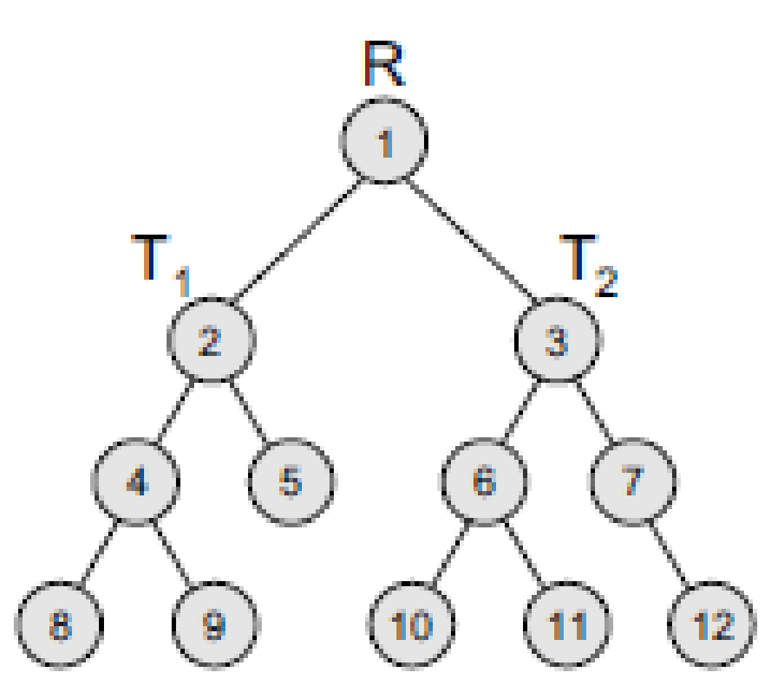
Trees
Figure shows a binary tree, where R is the root node and T1 and T2 are the left and right subtrees of R.
If T1 is non-empty, then T1 is said to be the left successor of R.
Likewise, if T2 is non-empty, then it is called the right successor of R.

Slide 16
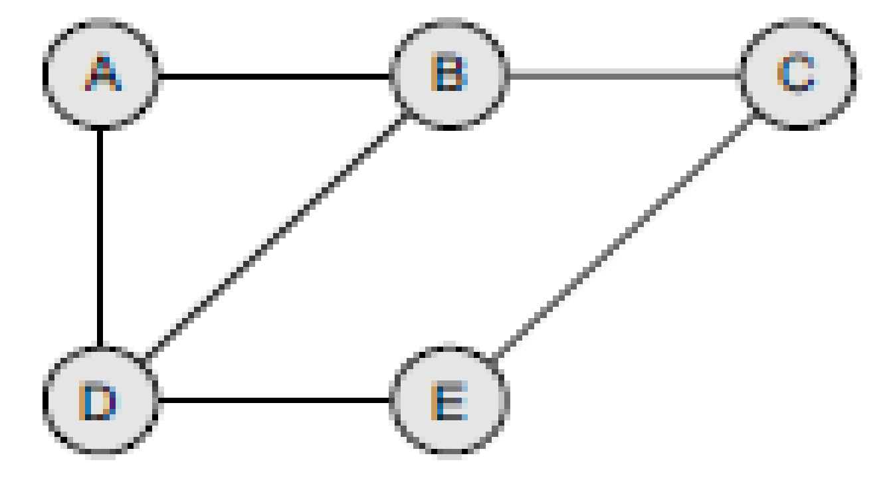
Graphs
A graph is a non-linear data structure which is a collection of vertices (also called nodes) and edges that connect these vertices.
A graph is often viewed as a generalization of the tree structure, where instead of a purely parent-to-child relationship between tree nodes, any kind of complex relationships between the nodes can exist.
In a tree structure, nodes can have any number of children but only one parent, a graph on the other hand relaxes all such kinds of restrictions.
Figure shows a graph with five nodes.

Slide 17
Graphs
A node in the graph may represent a city and the edges connecting the nodes can represent roads.
A graph can also be used to represent a computer network where the nodes are workstations and the edges are the network connections.
Graphs have so many applications in computer science and mathematics that several algorithms have been written to perform the standard graph operations, such as searching the graph and finding the shortest path between the nodes of a graph.
Note that unlike trees, graphs do not have any root node.
Rather, every node in the graph can be connected with every another node in the graph.
When two nodes are connected via an edge, the two nodes are known as neighbours.
For example, in Fig, node A has two neighbours: B and D.

Slide 18
Operations
Traversing
To visit or process each data exactly once in the data structure
Searching
To search for a particular value in the data structure for the given key value
Inserting
To add a new value to the data structure
Deleting
To remove a value from the data structure
Sorting
To arrange the values in the data structure in a particular order.
Merging
To join two same type of data structure values

Slide 19
Abstract Data Type
An abstract data type, sometimes abbreviated ADT, is a logical description of how we view the data and the operations that are allowed without regard to how they will be implemented.
By providing this level of abstraction, we are creating an encapsulation around the data. The idea is that by encapsulating the details of the implementation, we are hiding them from the user‘s view. This is called information hiding.
‹#›

Slide 20
Advantage of using ADTs
In the real world, programs evolve as a result of new requirements or constraints, so a modification to a program commonly requires a change in one or more of its data structures.
For example, if you want to add a new field to a student’s record to keep track of more information about each student, then it will be better to replace an array with a linked structure to improve the program’s efficiency.
In such a scenario, rewriting every procedure that uses the changed structure is not desirable.
Therefore, a better alternative is to separate the use of a data structure from the details of its implementation.
This is the principle underlying the use of abstract data types.

